Slide 1


Slide 3
“For Abraham will certainly become a great and mighty nation, and all the nations of the earth will be blessed through him. I have singled him out so that he will direct his sons and their families to keep the way of the Lord by doing what is right and just. Then I will do for Abraham all that I have promised.”
Genesis 18:18-19
Notes:
Timeless truth, Hasn’t changed,
God’s people are to be a blessing and we are to keep the way of the Lord by doing what is right and just.
India story

Slide 4
But you are not like that, for you are a chosen people. You are royal priests, a holy nation, God’s very own possession. As a result, you can show others the goodness of God, for he called you out of the darkness into his wonderful light.
“Once you had no identity as a people;
now you are God’s people.
Once you received no mercy;
now you have received God’s mercy.”
1 Peter 2:9-10

Slide 5
Dear friends, I warn you as “temporary residents and foreigners” to keep away from worldly desires that wage war against your very souls. Be careful to live properly among your unbelieving neighbors. Then even if they accuse you of doing wrong, they will see your honorable behavior, and they will give honor to God when he judges the world.
1 Peter 2:11-12
Notes:
We are to live as temporary residents, as disciples of Jesus. Our lives will be unusual.

Slide 6
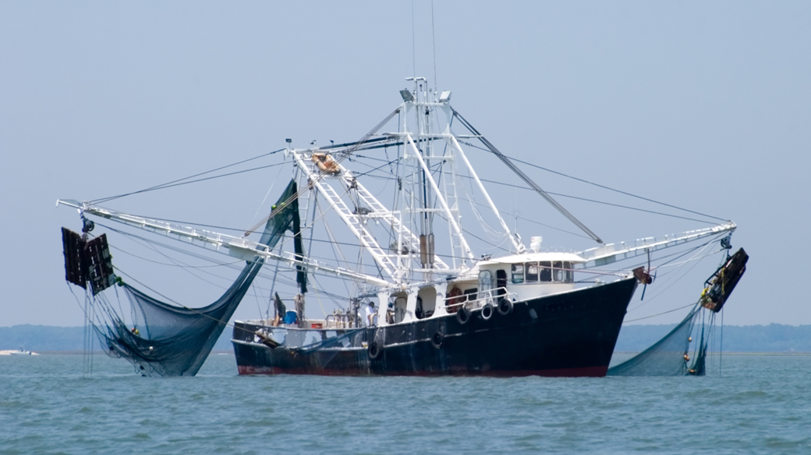

Slide 7
Again he said, “Peace be with you. As the Father has sent me, so I am sending you.”
John 20:21
Notes:
We are sent out. We are not to isolate ourselves from unbelievers. This hasn’t changed.

Slide 8
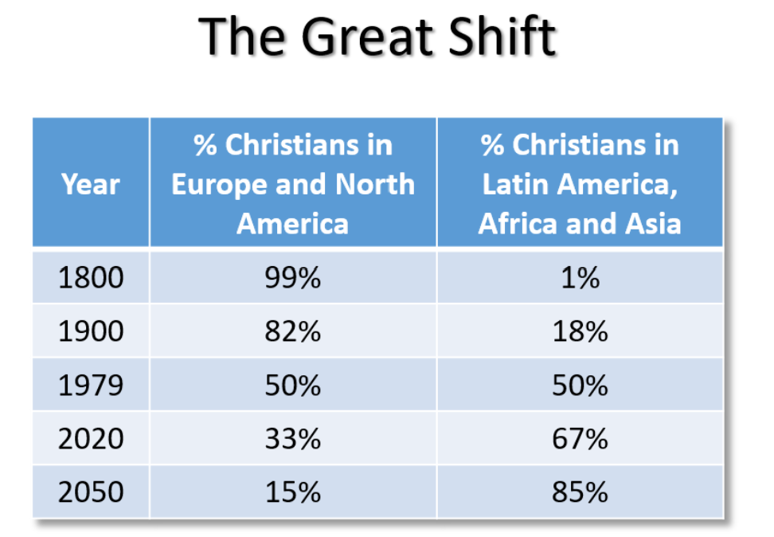

Slide 9
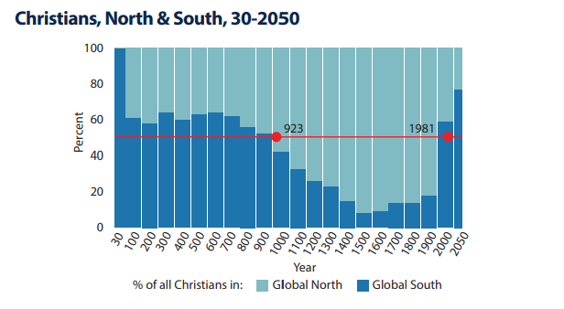


Slide 10
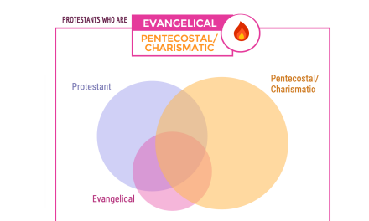

Slide 11
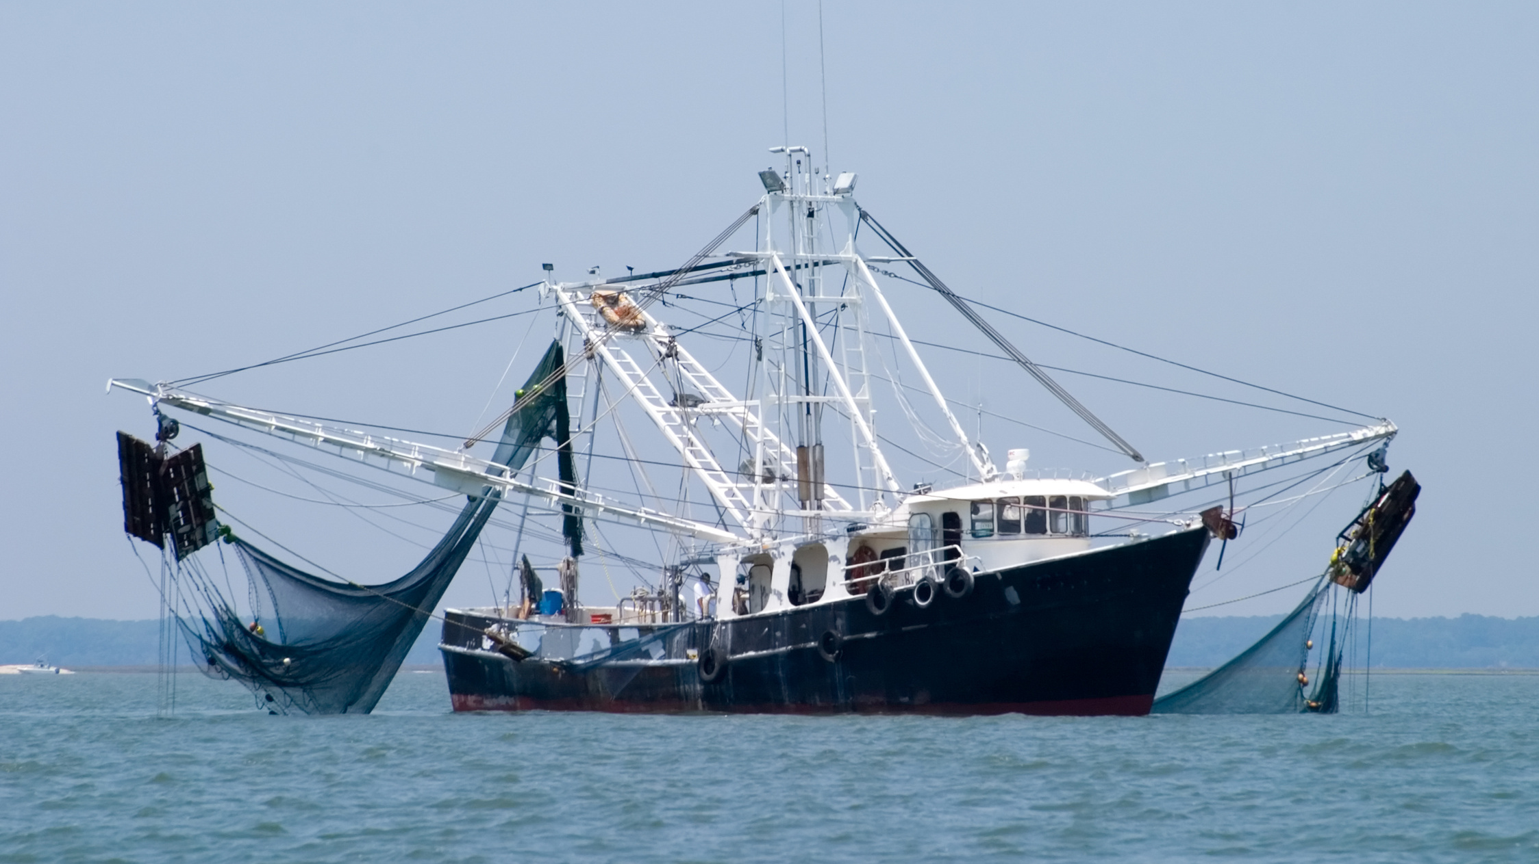
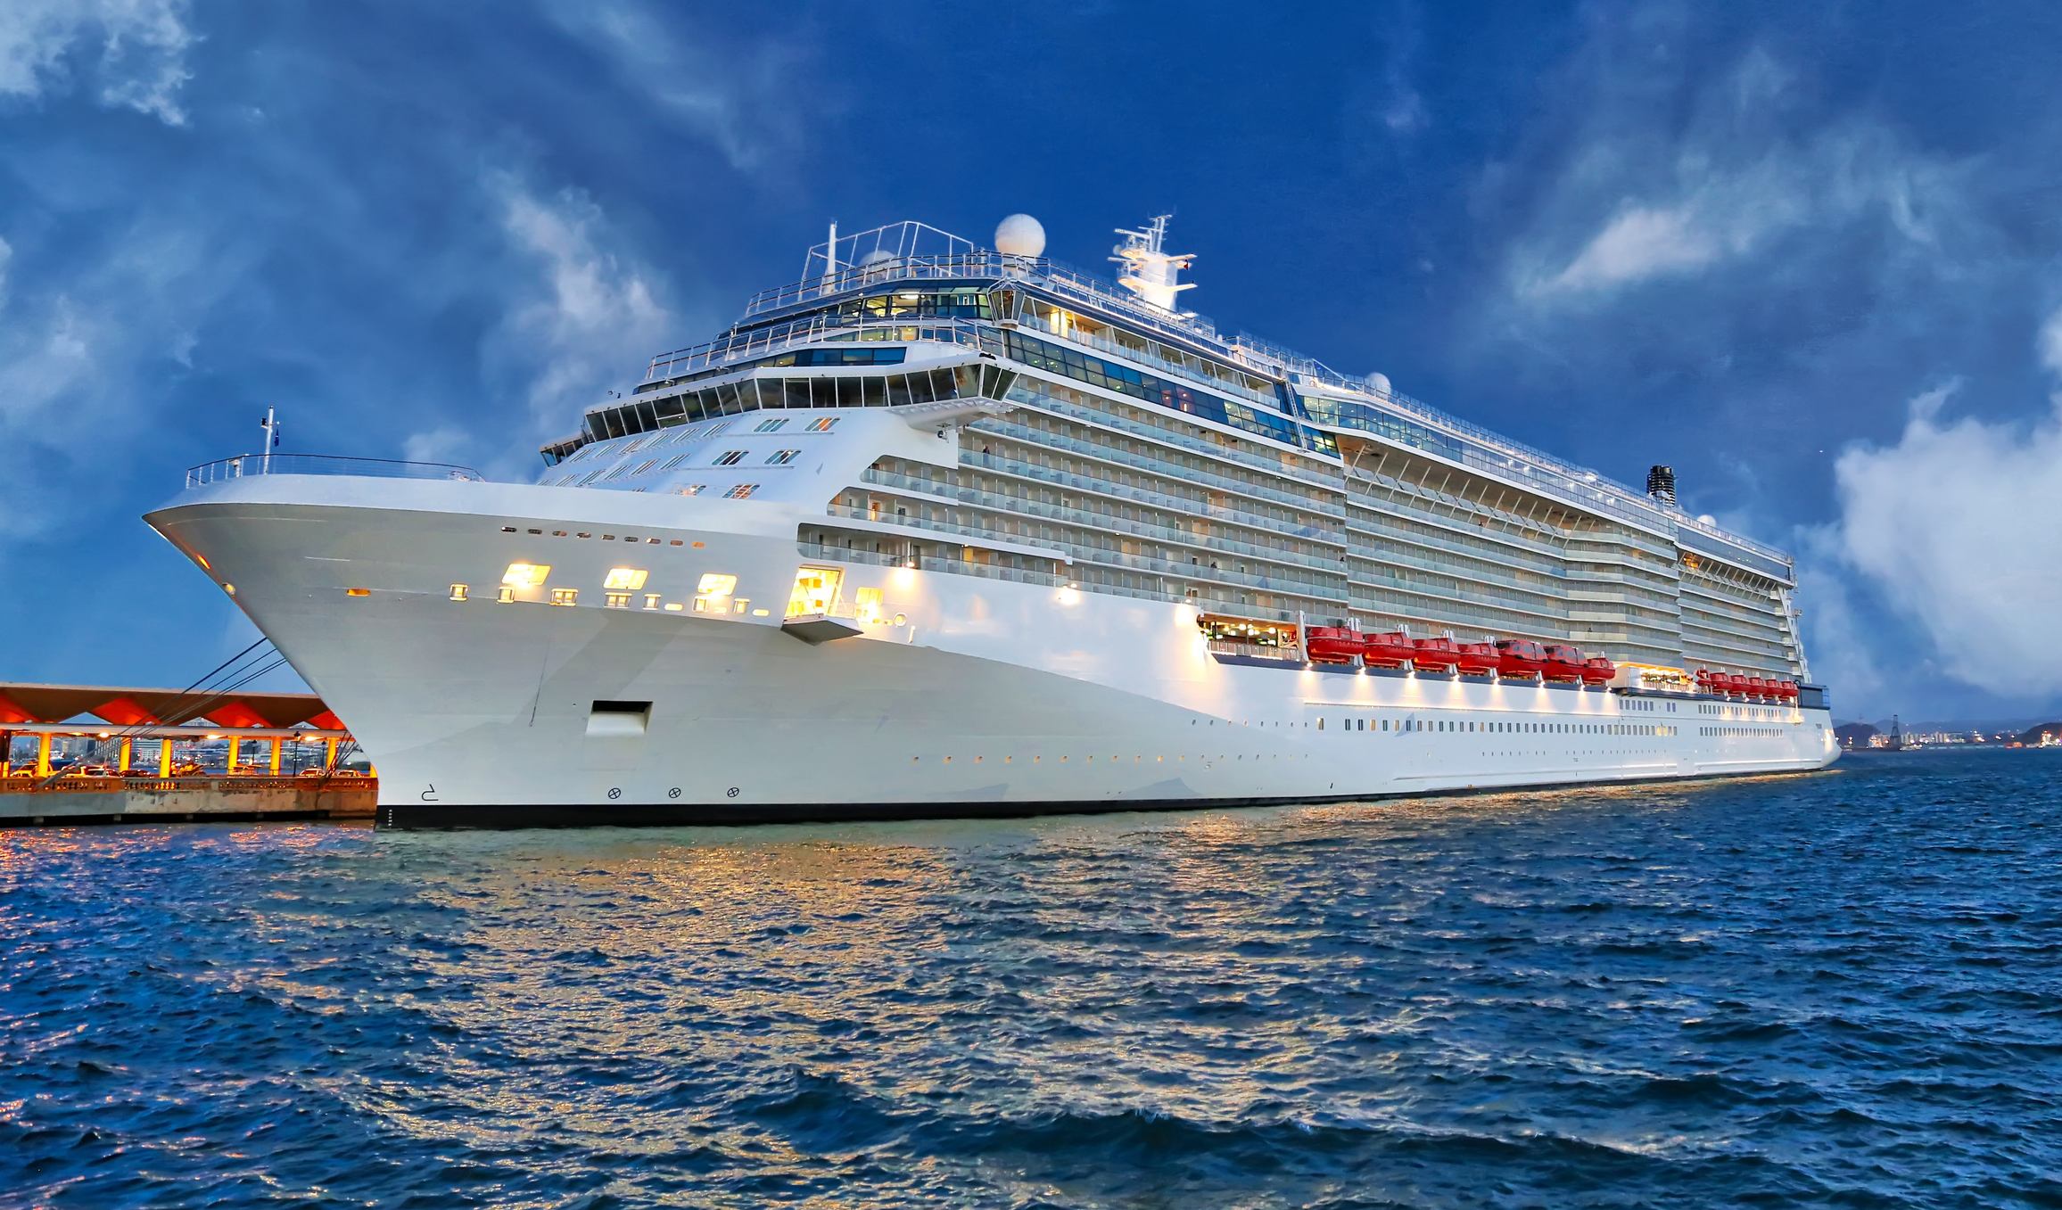
Notes:
If you wanted to maximize the number of fish that you caught, which boat would you want?
Qualification – willingness to do the hard work.

Slide 12
BIC U.S. World Missions
Quick Stats
65 Long Term Missionaries
Active work in 22 Countries
18 People discerning a call to long term missions
Over 40 people participating in short term disciplemaking trips this year.

Slide 13
A question was asked of Churchgoers:
Have you heard of the Great Commission?
51% - No
25% - Yes, but I can’t recall the exact meaning.
17% - Yes, and it means…
6% - Not sure
Source: Barna Study Published March 2018
Notes:
The majority of people in churches across the U.S. today, this morning do not know what the Great Commission is, and many of those who do, can’t recall the exact meaning.
I believe this reality is one of the primary reasons why the church in the U.S. is struggling.

Slide 14
Wherever Great Commission obedience falters, the church’s vibrancy begins to wane. Gospel-privileged peoples who do not keep the message flowing outward will eventually lose it themselves.
Steve Richardson

Slide 15
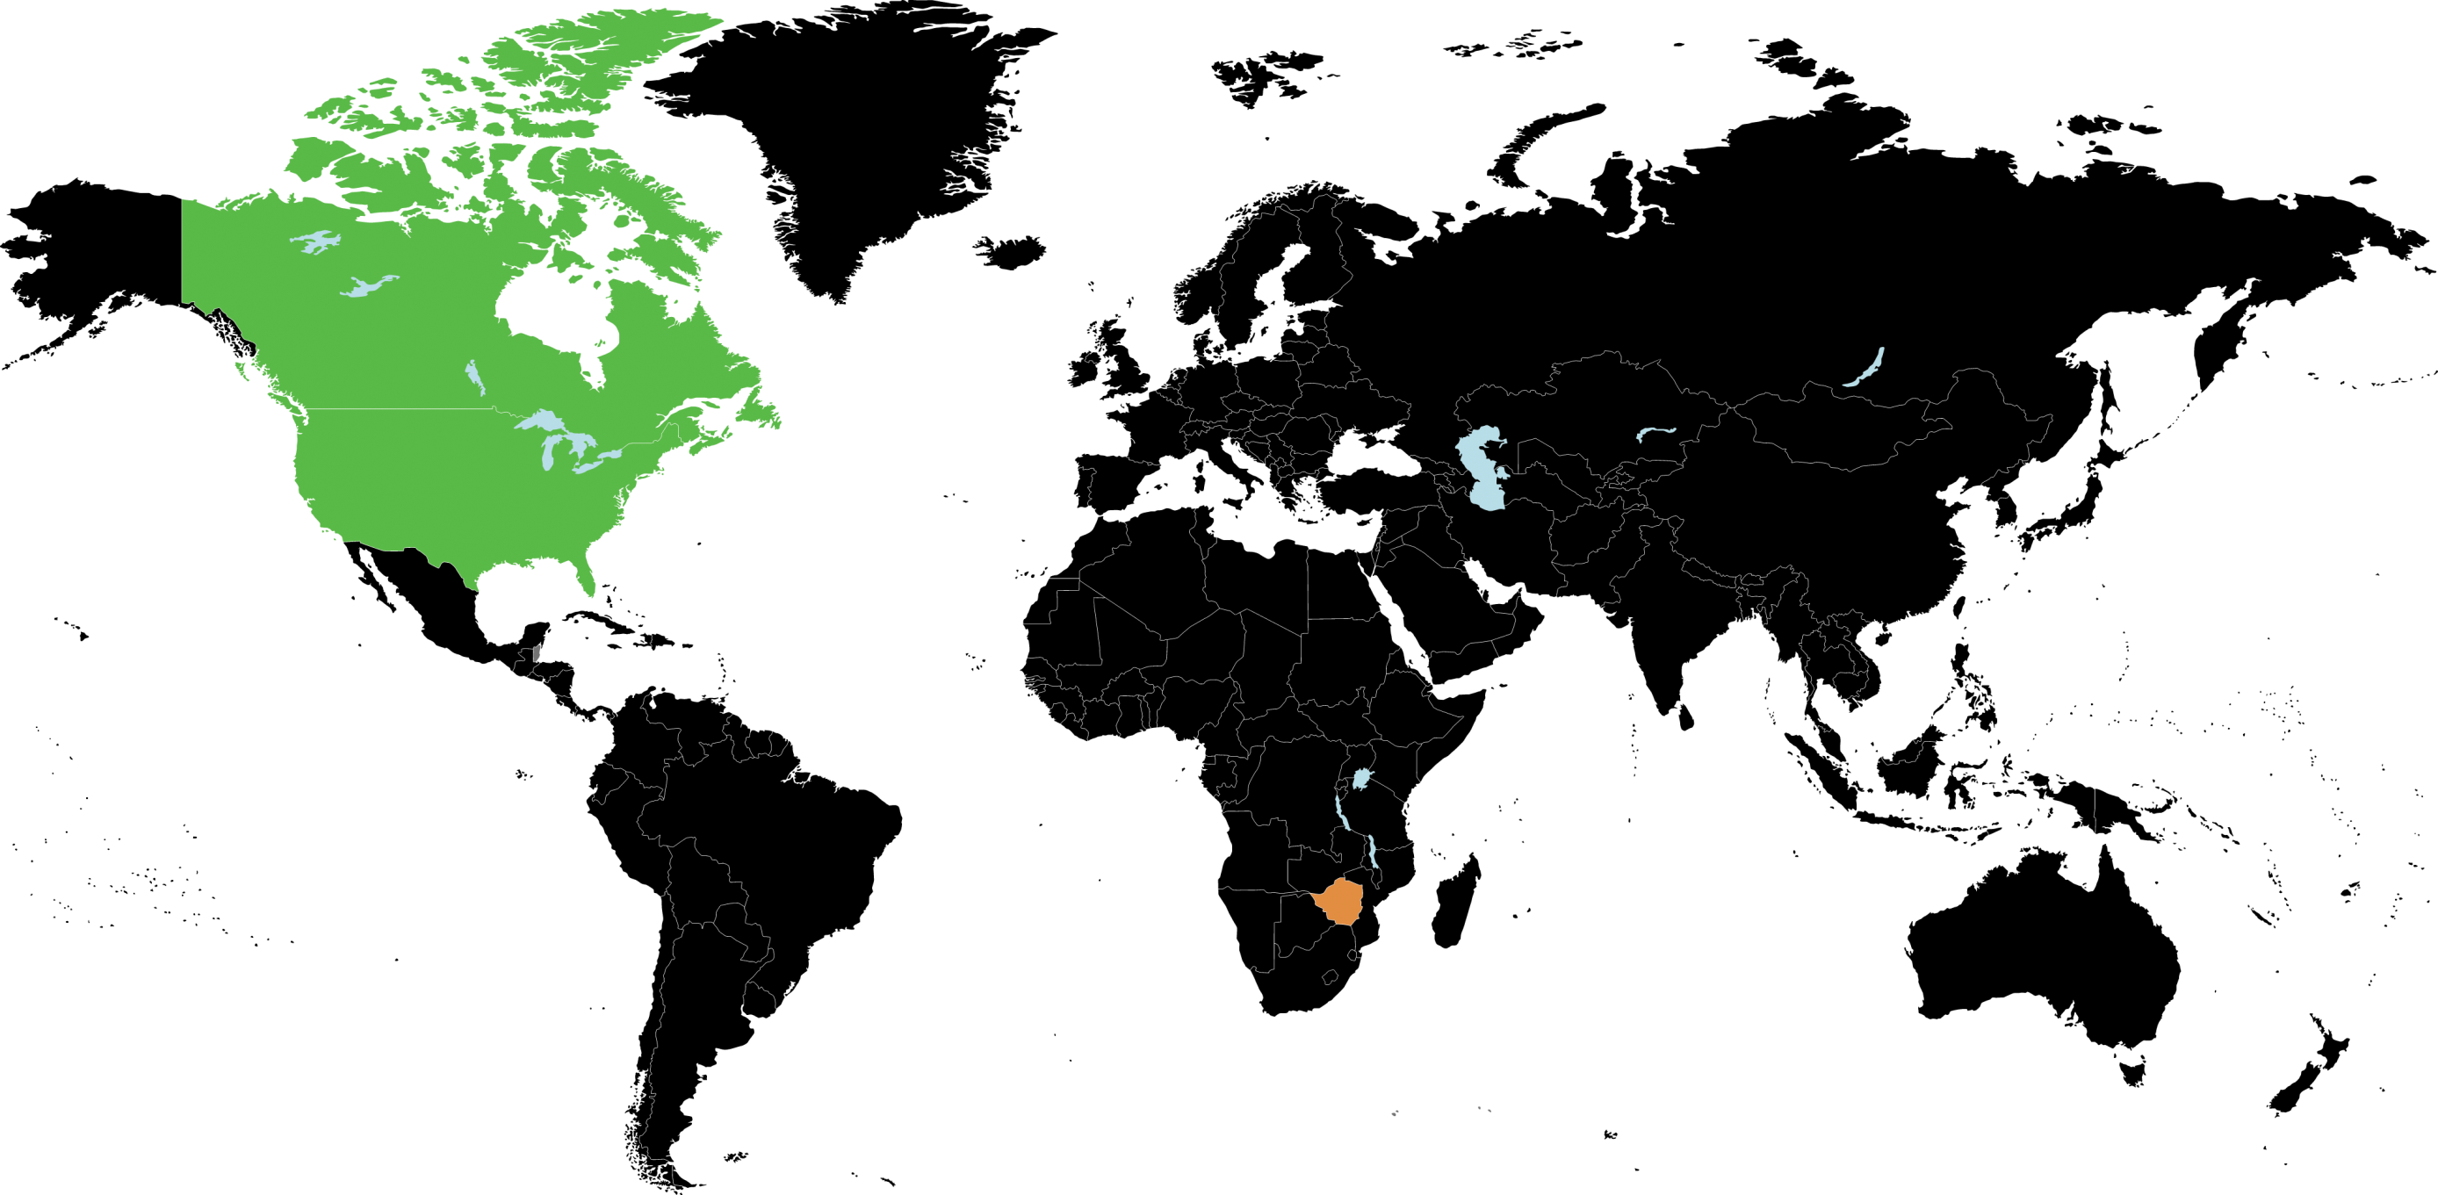
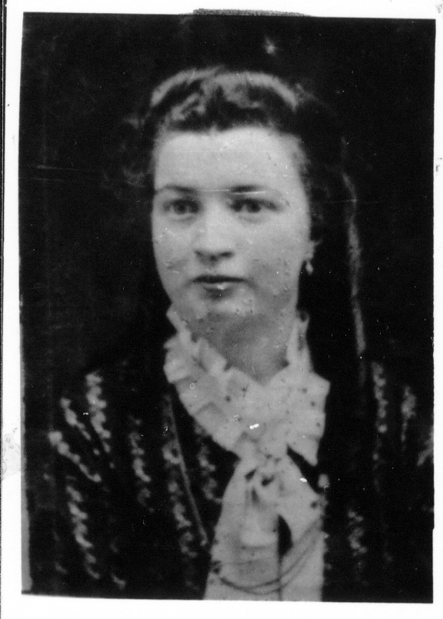
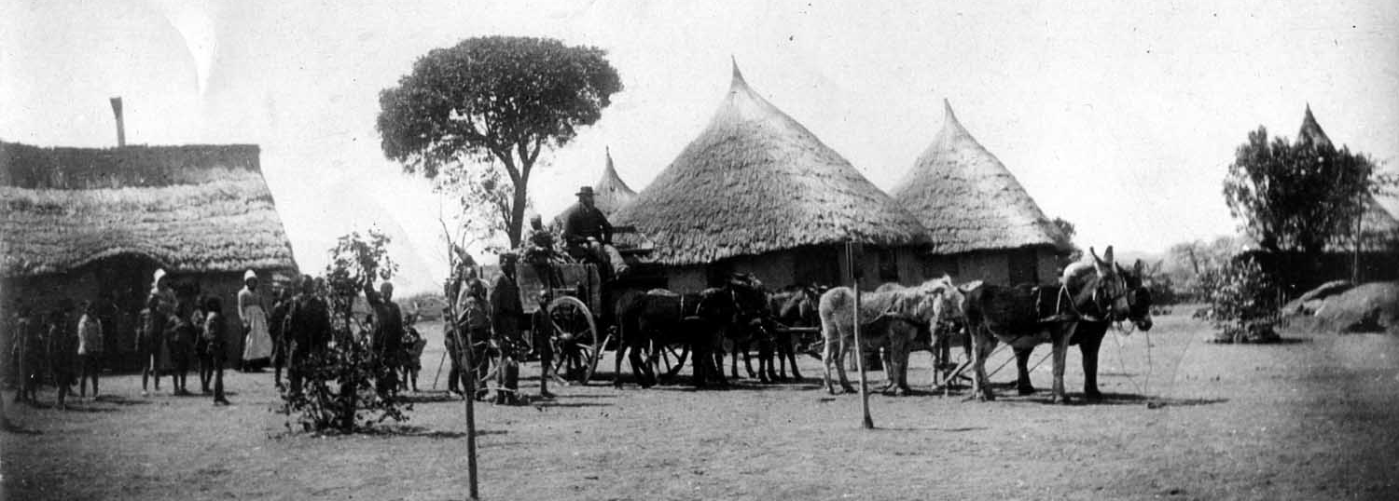
1898: Zimbabwe
Notes:
1898 – US to Zimbabwe (Southern Rhodesia)

Slide 16
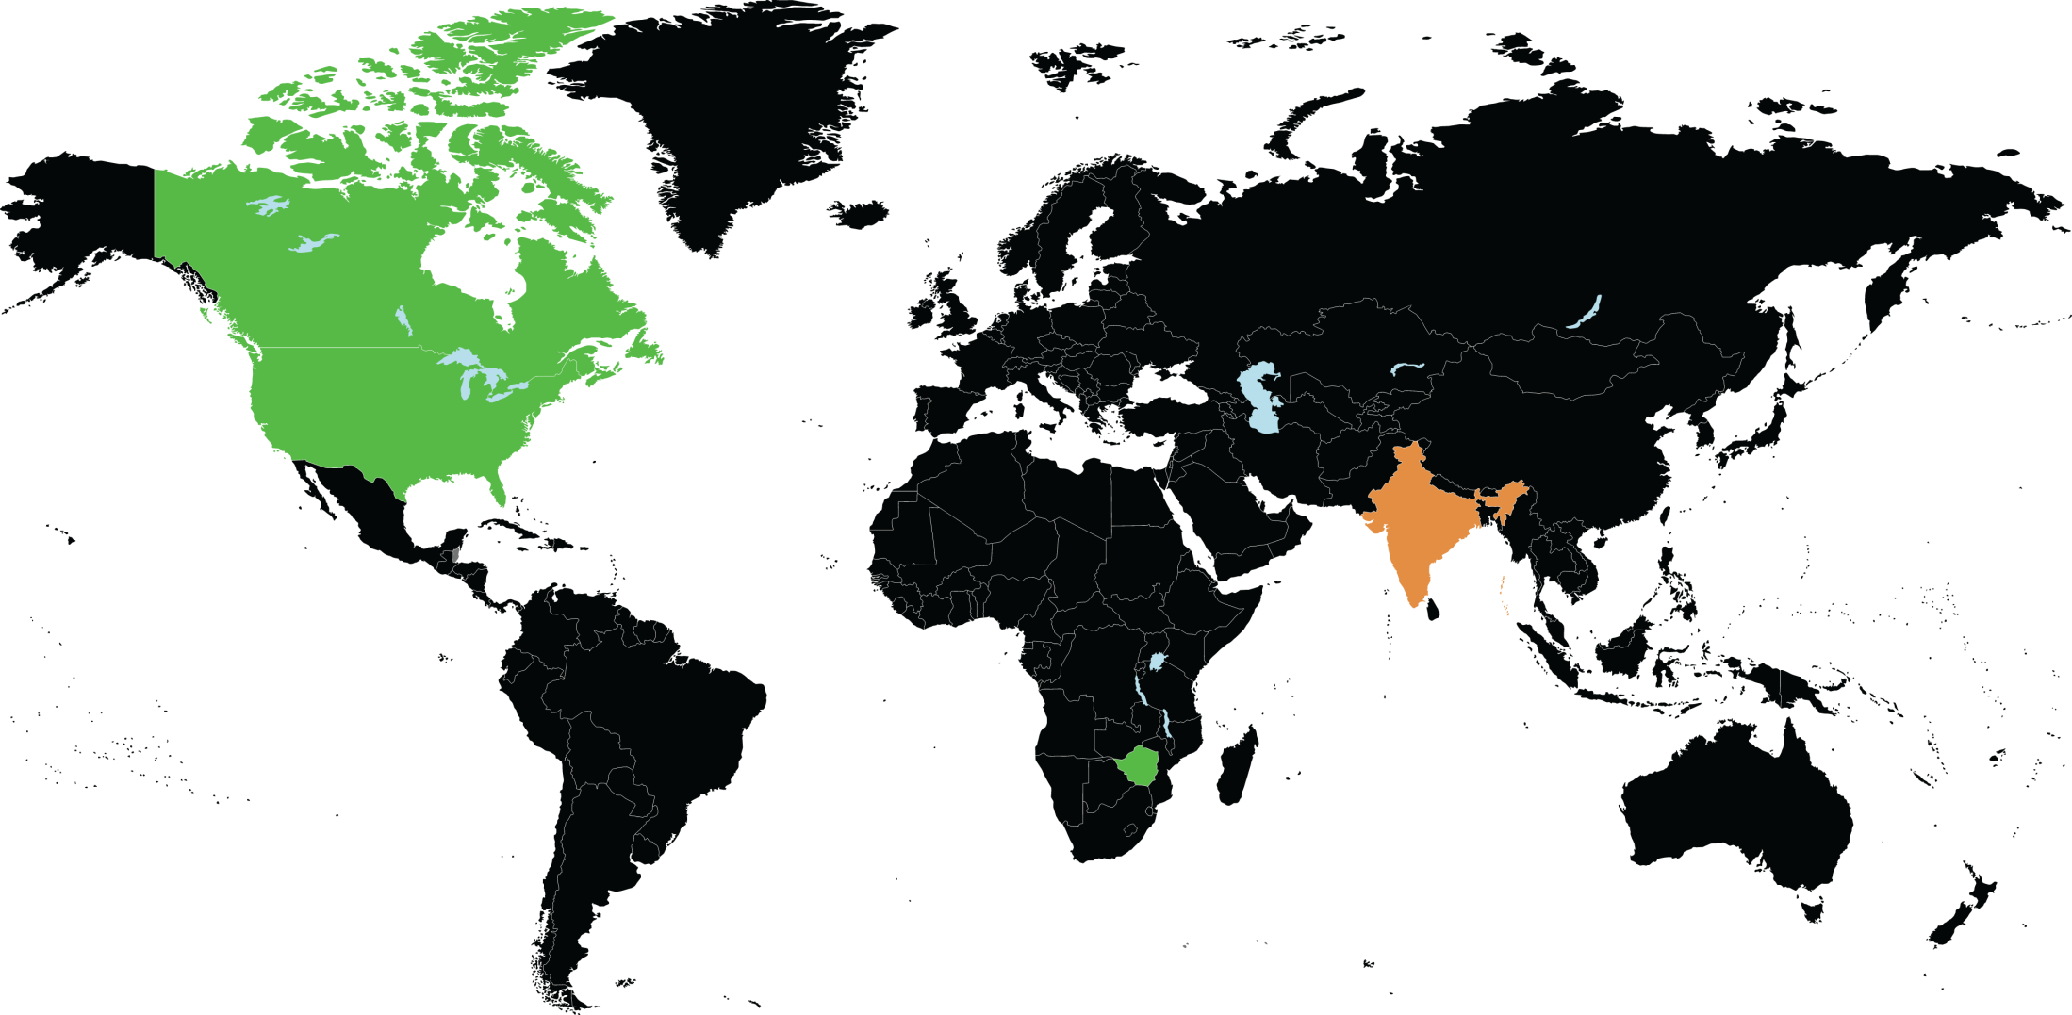
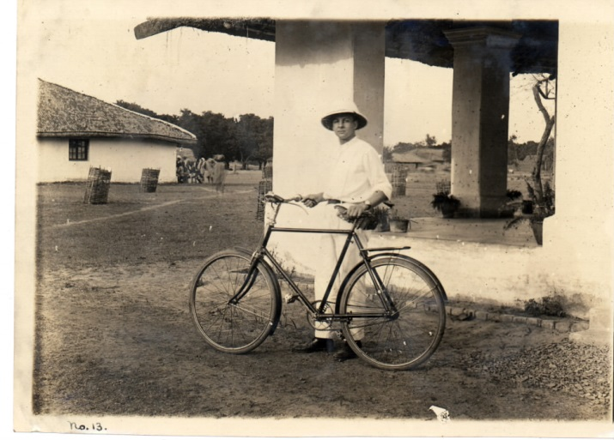
1904: Bihar, India
Notes:
1904 – US to India (Bihar)

Slide 17
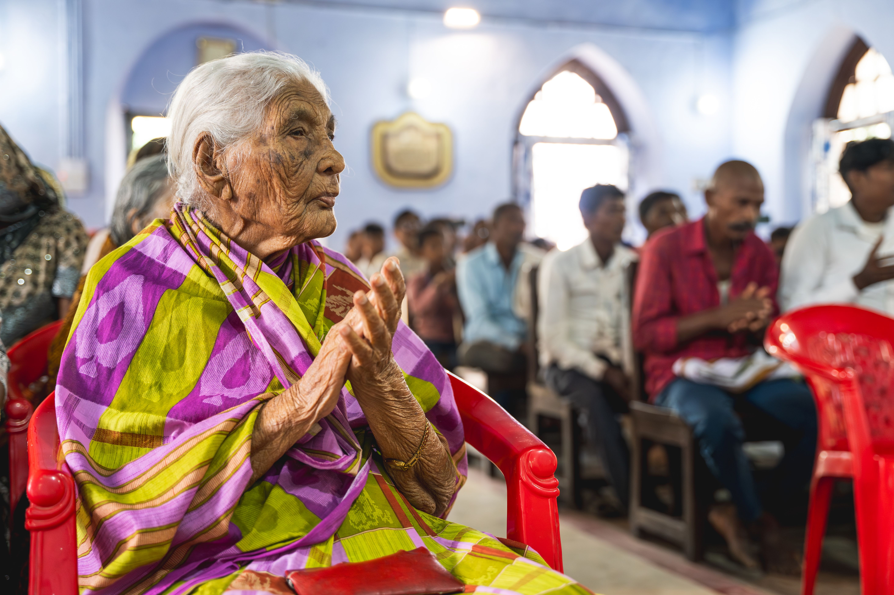
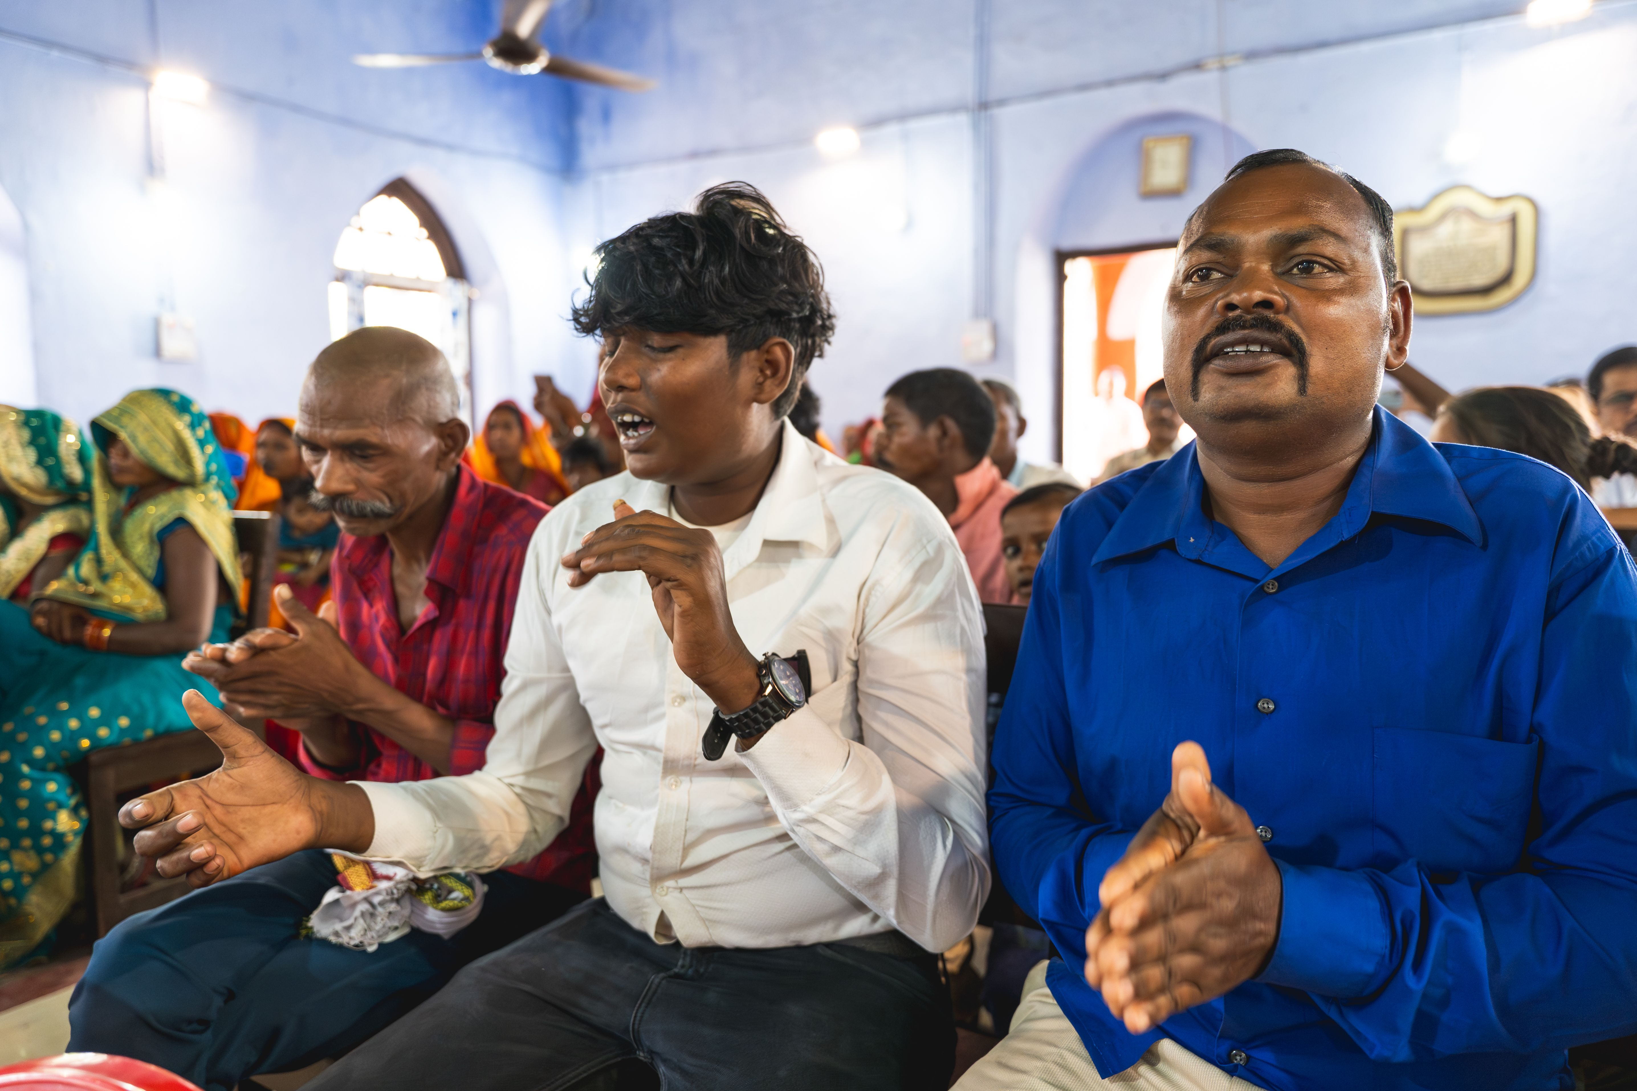

Slide 18
8.02 Billion People
3.2 Billion Virtually No Exposure to the Gospel
Joshua Project 2024

Slide 19
Opportunities with World Missions –
Short-term Learning and Service trips:
Short-Term Trips
  Samos Island, Greece – April 2026
  Dearborn, Michigan – July – August 2026
  Southeast Asia – December 2026
See us after the service or Contact missions@bicus.org for more information.
Notes:
These trips provide opportunities for God to change you, as well as for you to serve others. If you are into planning ahead, we will likely run all of these trips again in 2025. The only one that is still open for this year is the December Thailand trip. If you are interested in any of these you can sign up in the lobby or email missions@bicus.org.

Slide 20
Training opportunities with World Missions –
Mission Excellence Training for those interested in leading short-term trips: This training will be conducted online through zoom.
Faith Based Travel Security Training:
See us after the service or Contact missions@bicus.org for more information.
Notes:
These trips provide opportunities for God to change you, as well as for you to serve others. If you are into planning ahead, we will likely run all of these trips again in 2025. The only one that is still open for this year is the December Thailand trip. If you are interested in any of these you can sign up in the lobby or email missions@bicus.org.

Slide 21
After this I saw a vast crowd, too great to count, from every nation and tribe and people and language, standing in front of the throne and before the Lamb. They were clothed in white robes and held palm branches in their hands.
Revelation 7:9

Slide 22


